Slide 1
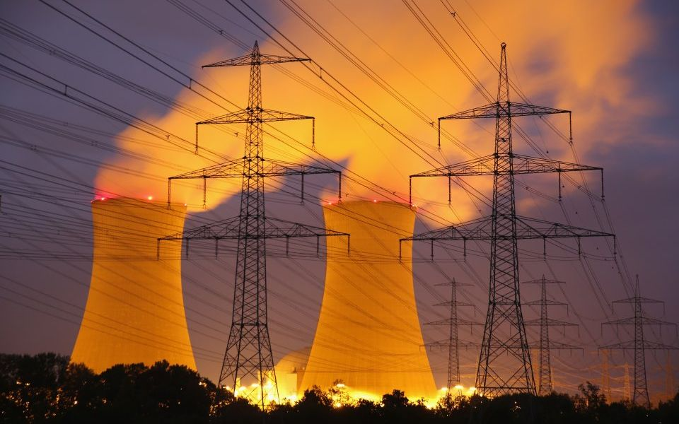
Integrating Nuclear and Renewable Energy Sources
Joseph Lee Adria Peterkin Pedro Vicente

Slide 2

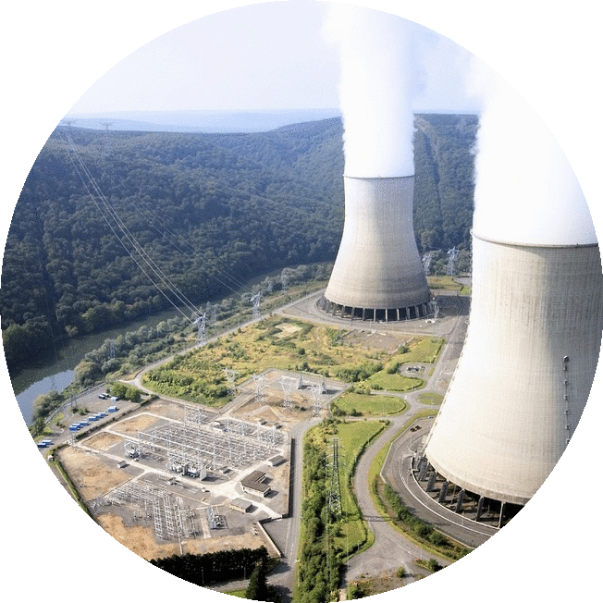

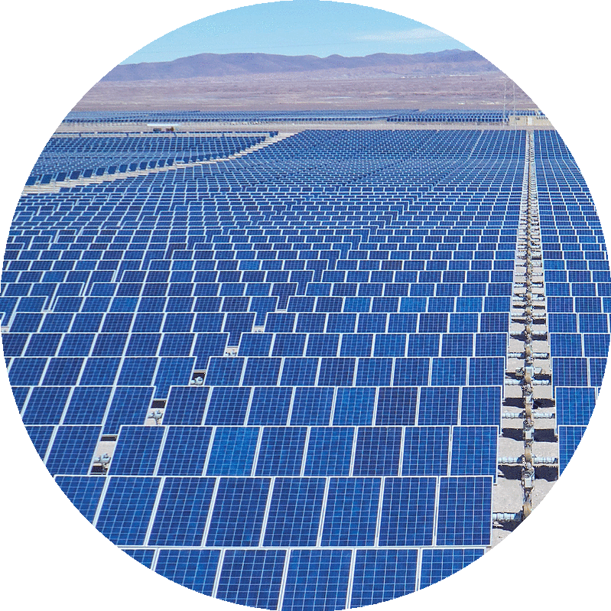



Shortcomings of power generation Methods
Fossil Fuels Nuclear
Renewables
Pros
Steady production
Load following
Cheap
Cons
GHG emissions
Environmental impact from fuel retrieval
Pros
Steady production
No GHG emission during operation
Cons
Expensive construction
Expensive licensing
No load following
Pros
No GHG
No fuel constraints
Low operational costs
Cons
Expensive
Irregular energy production
Uncontrollable output
Notes:
Pedro
In the currently available solutions, the main contenders are fossil fuels, nuclear, and renewables.
About two thirds of our energy comes from fossil fuels. Fossil fuels are extremely cheap and produce a steady amount of energy that can be ramped up when needed. Obviously, the downsides of fossil fuels stem from its production of GHG and that fuel retrieval methods are usually detrimental to the environment they are taken from.
On a similar vein, nuclear energy produces a large amount steady amount of energy without producing GHG. On the flipside, they have high base prices due to the stringent regulations which is makes them unattractive to construct and they are unable to change their power output economically so they end up losing a lot of revenue at low demand hours.
Renewables produce clean energy and they have low operational costs because their fuel is technically infinite. The downsides are that it they are still expensive compared to other energy sources and that their production times and amount depend heavily on weather conditions. This negatively affects grid stability since the energy source isn’t reliable.

Slide 3
Defining a Hybrid Energy System
Nuclear Power
Renewable Energy
Secondary System

Slide 4
The Nuclear-Hydrogen Hybrid System
Electricity Production
Thermal Energy
Hydrogen Production
Notes:
Adria
The idea of how this works is very simple. We have a set amount of thermal energy available and we can allot this thermal energy to electricity production or hydrogen production depending on the electricity demand. So we can split this thermal energy is as such in times of of high electricity demand, moderate demand, and low demand.

Slide 5
Nuclear Reactor Options
Supercritical- water cooled Reactor (SWCR)
Limited Research
Very High Pressure and Temperature
Temperature: 950-1022
Pressure: Very HIgh
Fuel: UO₂
Very High Temperature Reactor (VHTR)
Temperature: 1000C
Pressure: Very high
Fuel: UO₂ prism
Fuel may not be rotated out when it needs to be
Limited Research
Molten Salt Reactor (MSR)
High Corrosion potential
Temperature: 700-800C
Pressure: low ( ~ atmospheric)
Fuel: UF in Salt ( Molten)
Safer than conventional plants
More cost effective
Notes:
Adria
Briefly mention why Gen IV reactor compared to other generations
Compare different Gen IV reactors (specifically other reactors that were mentioned in HES papers)
Compare each and talk about why MSR was the best choice

Slide 6
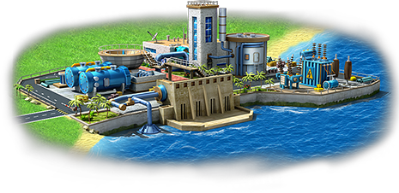
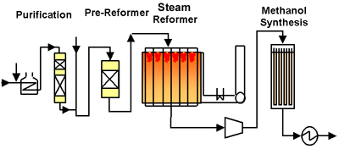
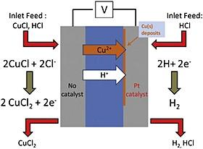
Options for a Secondary System
Desalination Plant
Methanol Production
Hydrogen Production
Needs a surplus amount of energy
Not economically feasible
High Temperature requirements
GHG produced during production
Economically feasible
Low Temperature requirements
Economically economically feasible
Notes:
Adria
Mention the uses of each and why both the Desalination and Methanol plant were ruled out
Finish with why Hydrogen was the most “liked” choice for the system

Slide 7
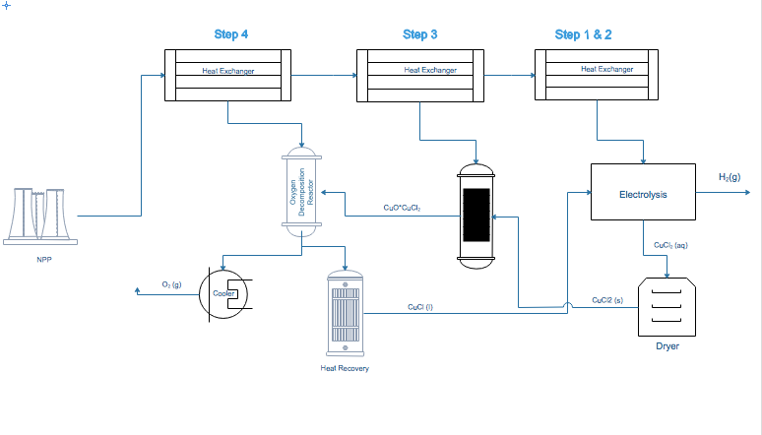
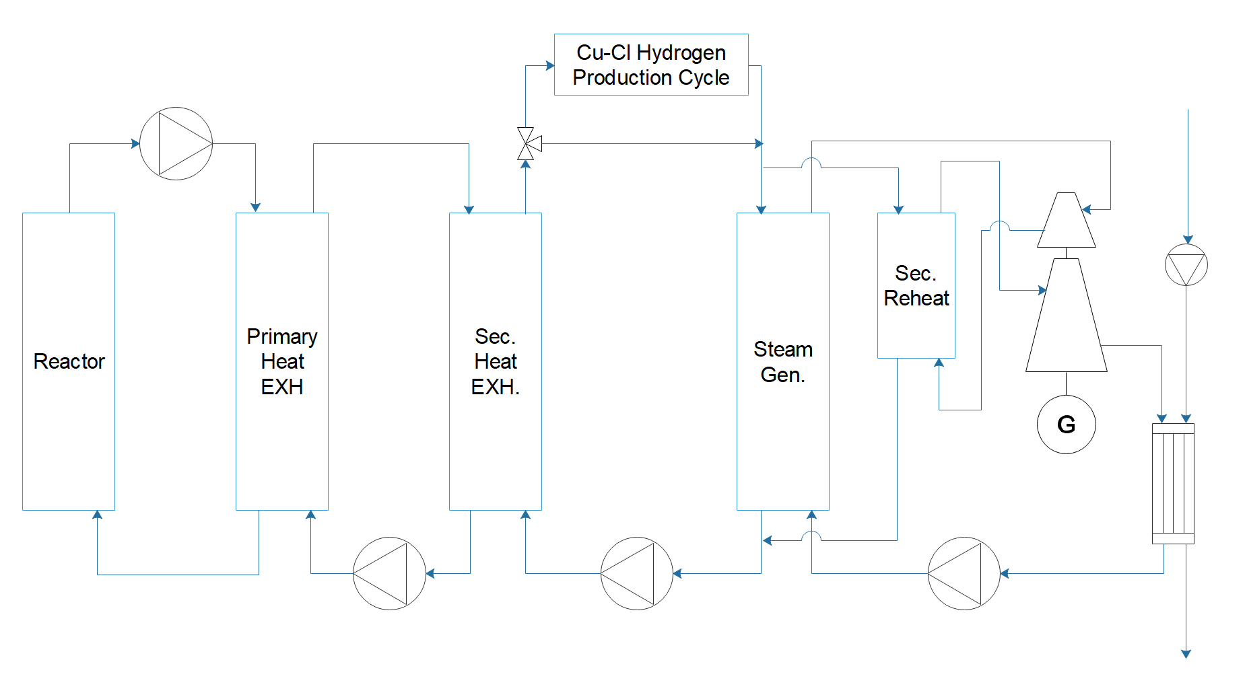
Our Design - Integration of a Molten Salt Reactor and a Cu-Cl Cycle Hydrogen Production
Notes:
Adria

Slide 8
Methods: Code
Input
Simulink/Matlab
Output
ThorCon MSR
Supercritical steam generator eq
Valve movement delay
Hydrogen production ramping time
Cost of multiple hydrogen plants
Energy Production
Electricity Demand
Hydrogen Production
Notes:
So how this all works is that we plug an electricity demand, either artificially created or based off of real data, into our model. This model then spits out what our energy and hydrogen production looks like as a function of time and from this data we can determine the economic benefit of this interconnection. Now the model’s characteristics are drawn from all sorts of different sources that make the system behavior more accurate.

Slide 9
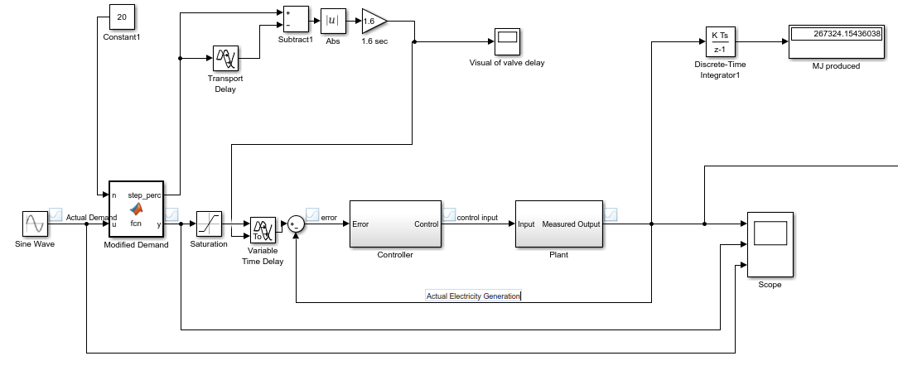
Simulink Model
Notes:
We used simulink to characterize how our system shifts with changing demands and for those of you who don’t know, simulink is a modeling software primarily used for time dependent dynamic system.
Now this is glance into the energy production side of our simulink model. While I wont cover what every block in this diagram does, I will briefly cover where different component and system characteristics that I talked about earlier start to come into play. Now this here is where we put in the energy demand that our system is trying to more or less mimic. This section here is the time delay in the system caused by the movement of our valves. And this here is the delay caused by the system reaching a flow equilibrium.

Slide 10
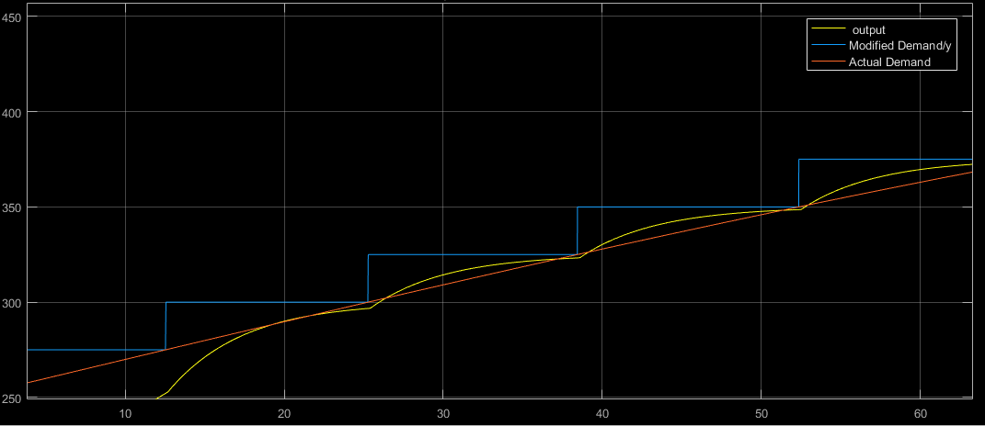
Simulink Graph
Electricity (MW)
Time (seconds)
Notes:
This is what the output of that diagram would look like. This orange line here is the actual demand that we put into our model. This blue line is a modified demand and the reason it’s a discrete step function is to limit system fluctuations. If the system tried to perfectly follow the demand, it’d run into issues like under production and would cause more issues in the hydrogen production side of plant operations which needs a steadier flow of heat.

Slide 11
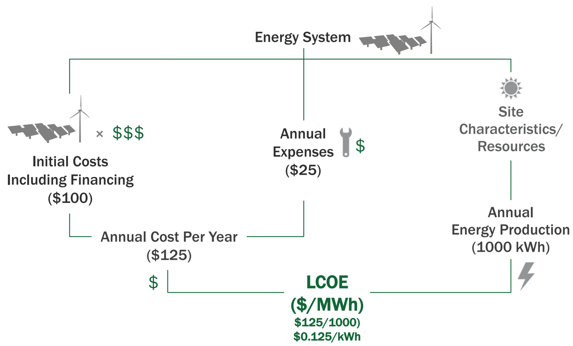

Economic Benefits - Levelized cost of Electricity
Notes:
Capital cost, cost of capital/financial structure, interest during construction, commodity material costs, etc.? – Fuel cost; Resource availability and quality; Site issues; etc.? – Capacity factor realized, etc.? – Transmission; interconnection costs; integration costs? – Operations? • Dispatchable? Ramp rates? • Reserves? – Other costs? • Water consumption? • Environmental impacts—land, water, atmosphere, climate, biosphere? • Etc.

Slide 12
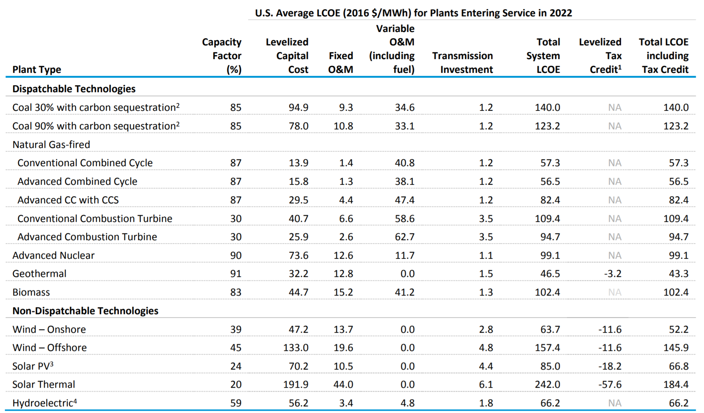
Economic Benefits - Comparing LCOE

Slide 13
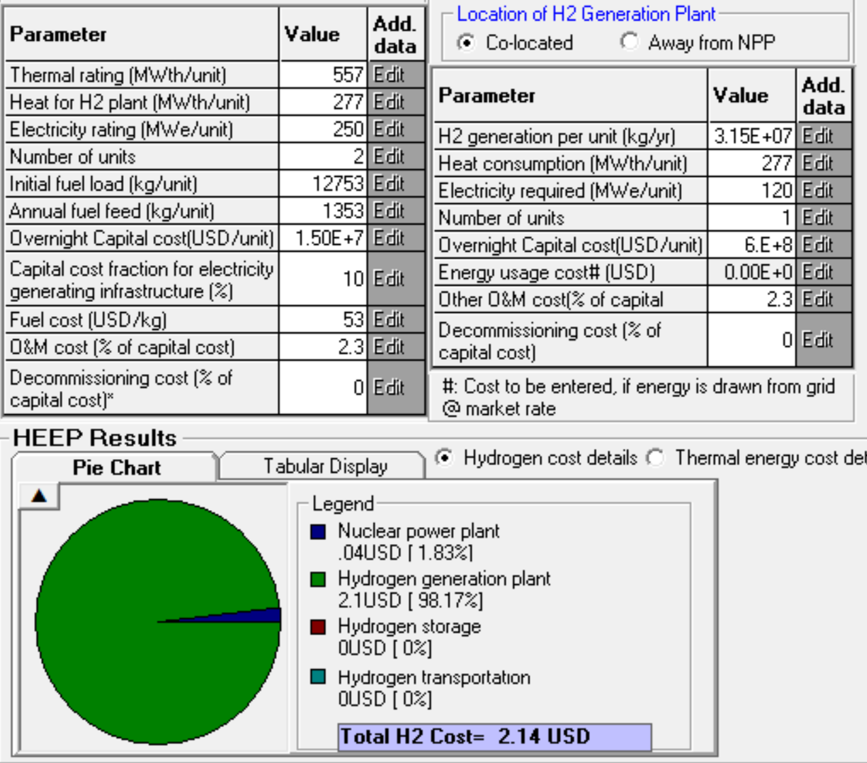
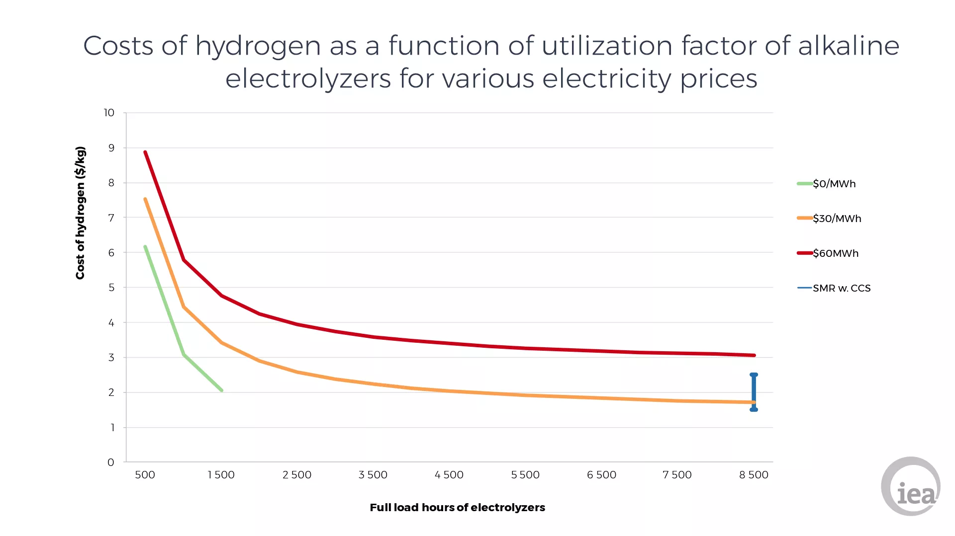
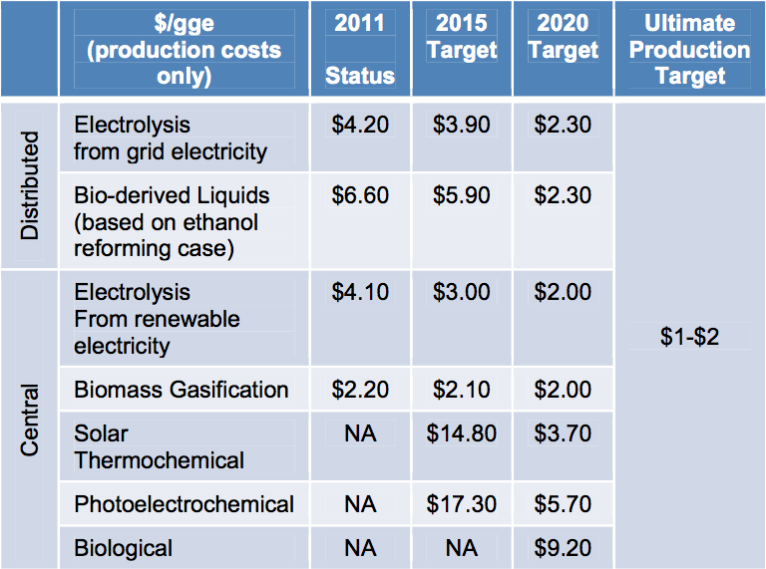
Economic Benefits - Hydrogen Production
Notes:
Hydrogen fuel prices range from $12.85 to more than $16 per kilogram (kg), but the most common price is $13.99 per kg (equivalent on a price per energy basis to $5.60 per gallon of gasoline)

Slide 14

Take Away Points
The current mode of Energy Production cannot support the grid nor the environment long term
Hybrid Energy Systems are important for achieving a sustainable grid
Coupling a secondary industry process to a nuclear power plant results in a higher overall energy efficiency and therefore better economics.

